Slide 1
Sprint 2 Deliverable
Team Yellow
Janet Gregoire, Dakota Kronberger, & Nicholas Roush

Slide 2
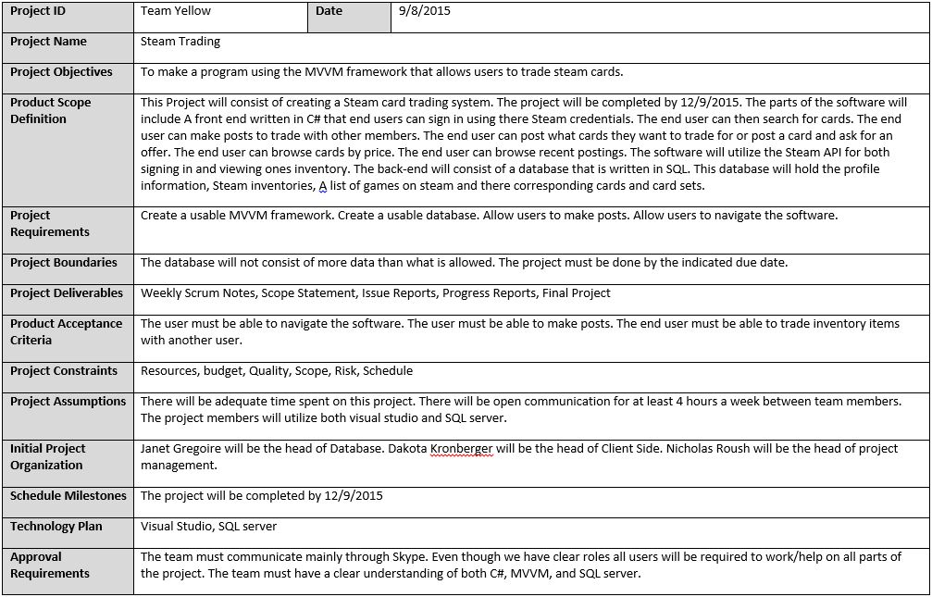
Scope Document

Slide 3
Multi-Sprint Plan
Sprint 1 - Complete a mockup
Sprint 2 - Create a working database. The program will have the ability to create posts and edit them. The posts will be saved to the database to be used later.
Sprint 3 - Create framework for editing data sets, one-to-one data sets, one-to-many data sets, and many-to-many data sets. Implement paging of data. Implement sorting of data. Implement searching of data
Sprint 4 - Validate data using Regex expressions. Validate data using data binding and built-in validation features. Validate data using appropriate user interface control types.
Sprint 5 - Create a user manual for an application. Export results in a presentable format.

Slide 4
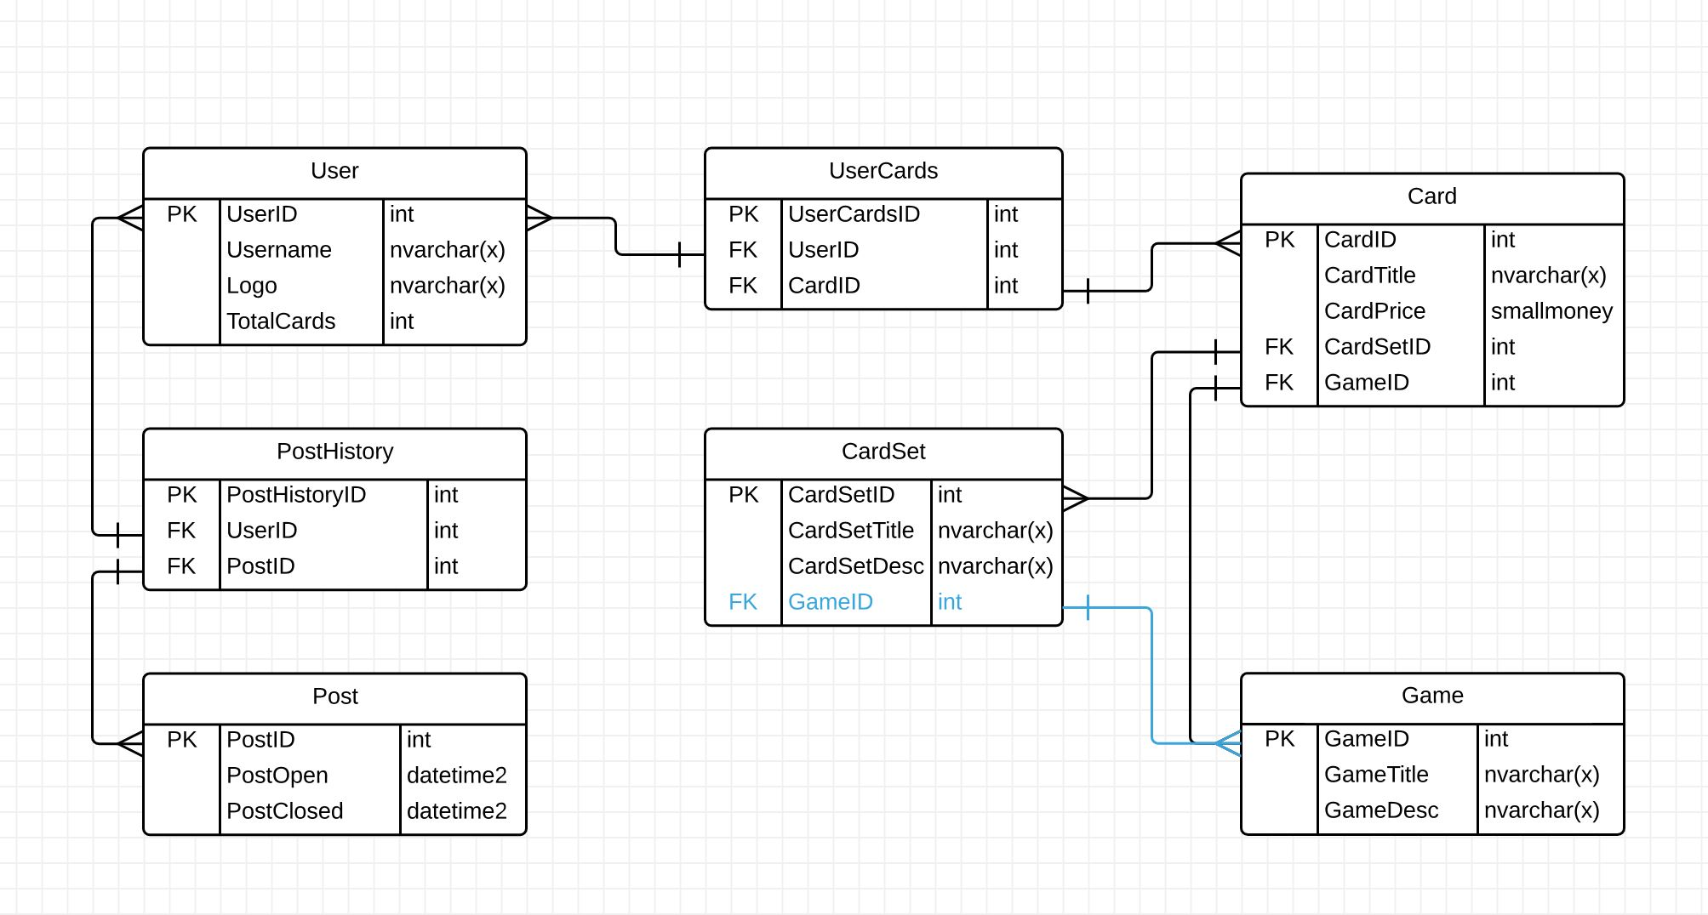
Crows Foot ERD

Slide 5
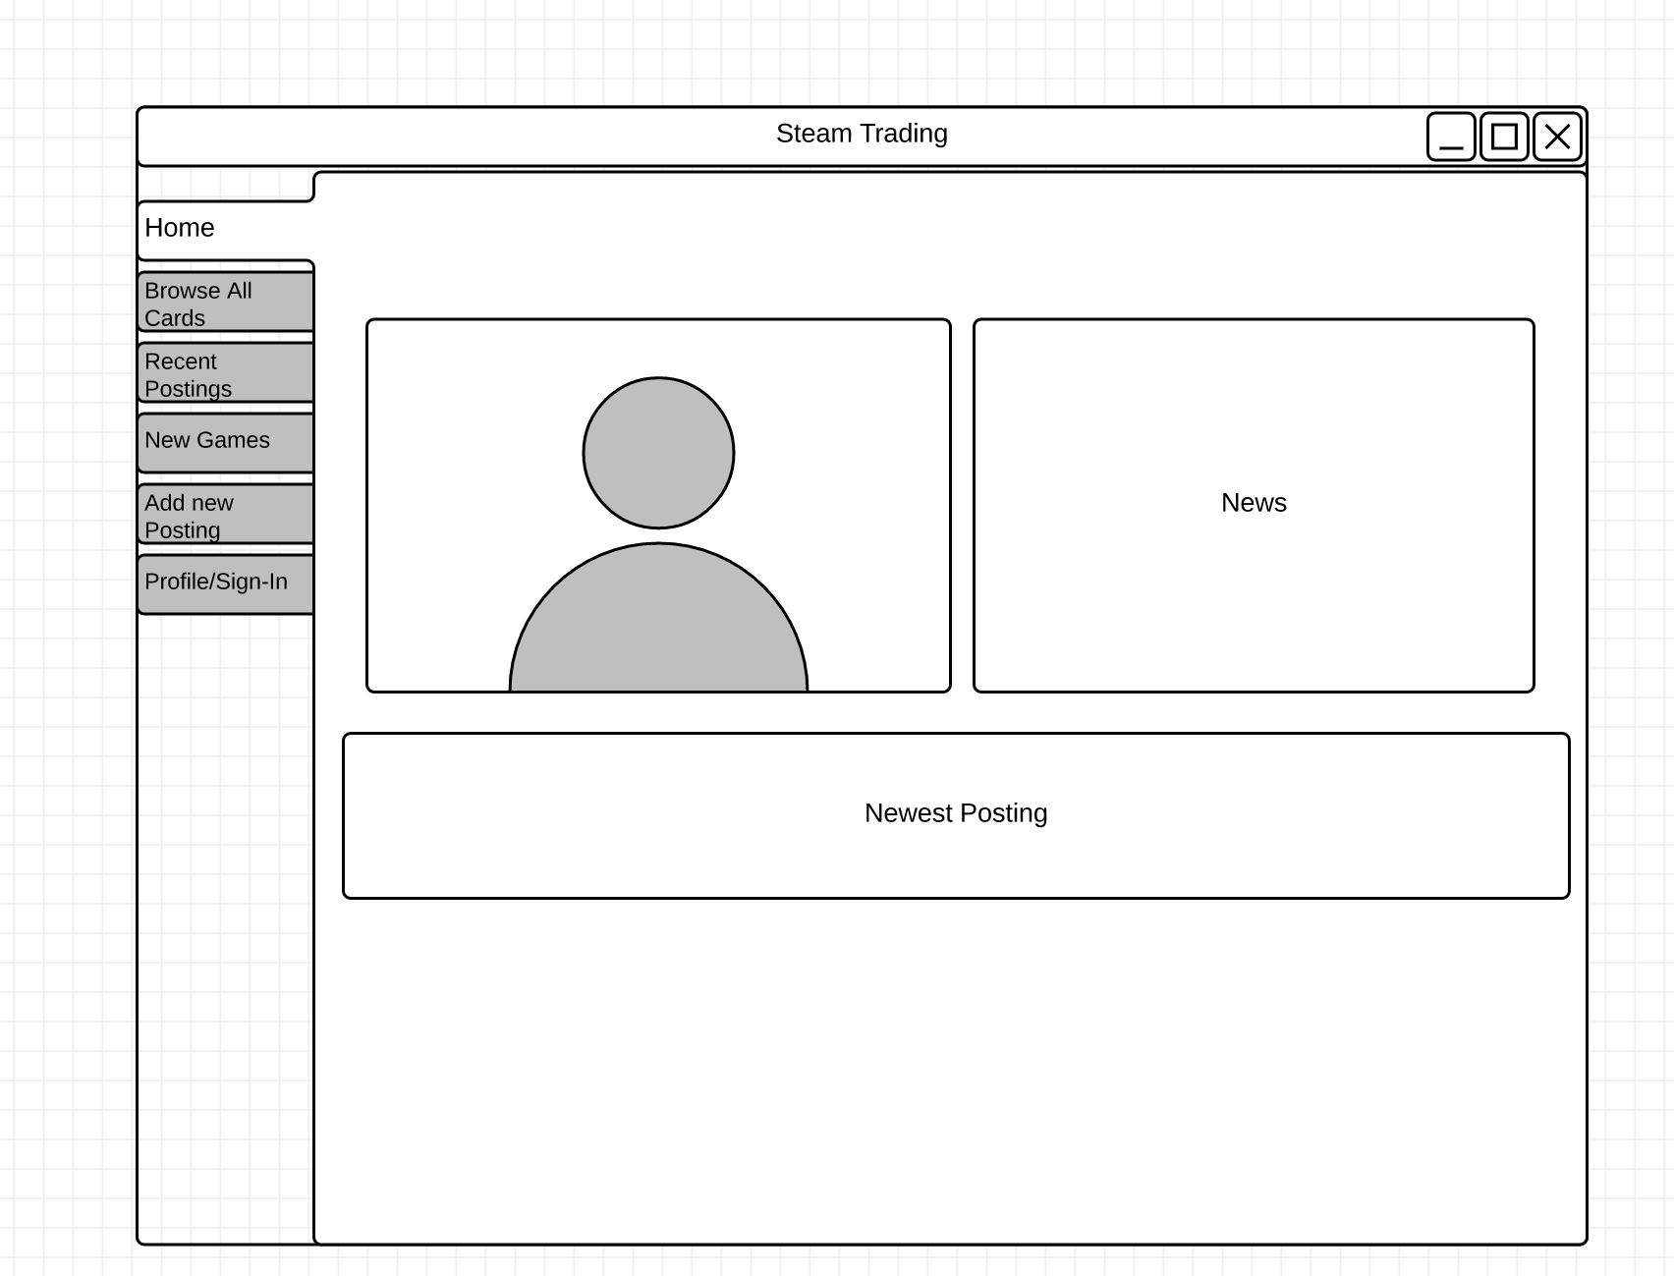
Mockup: Home

Slide 6
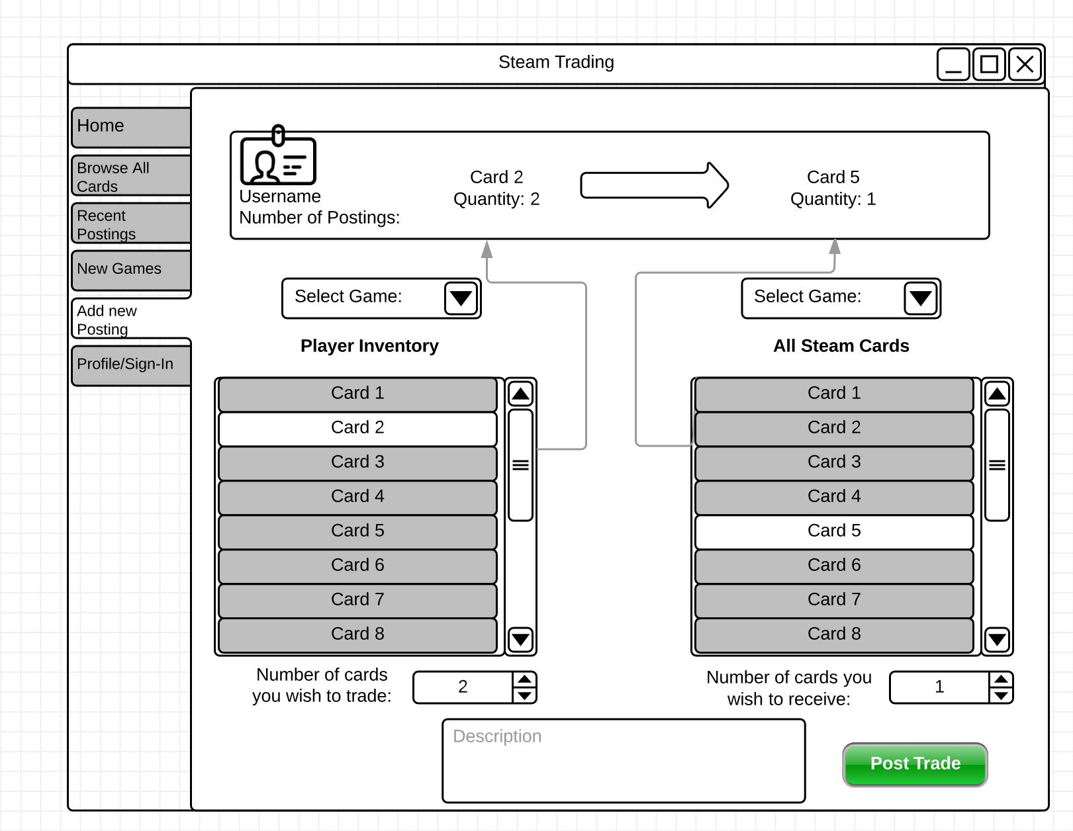
Mockup: Add Post

Slide 7
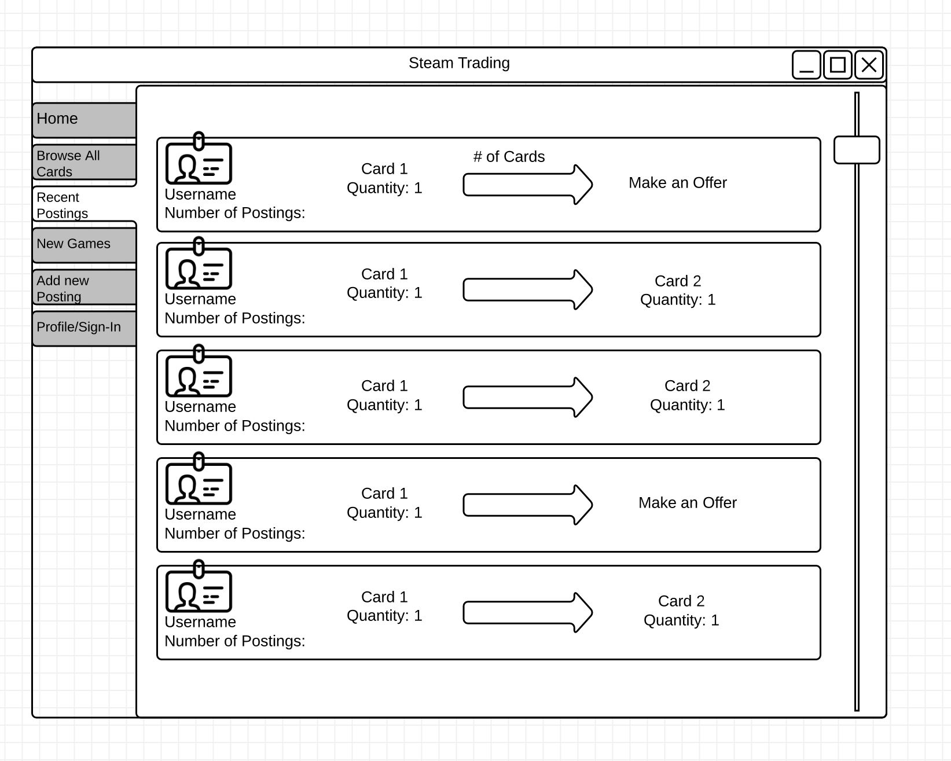
Mockup: Posts

Slide 8
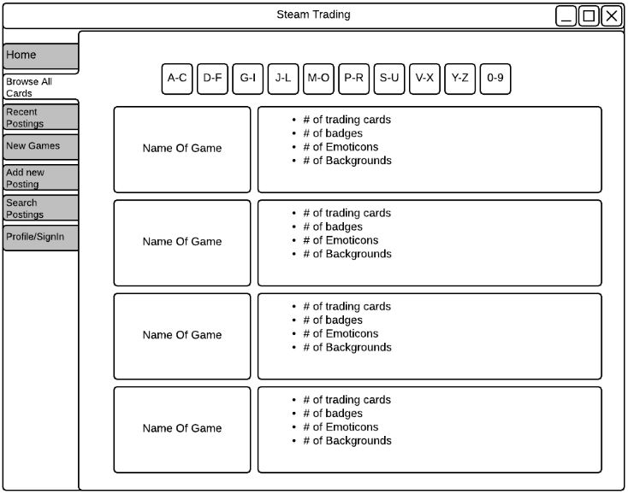
Mockup: Cards

Slide 9
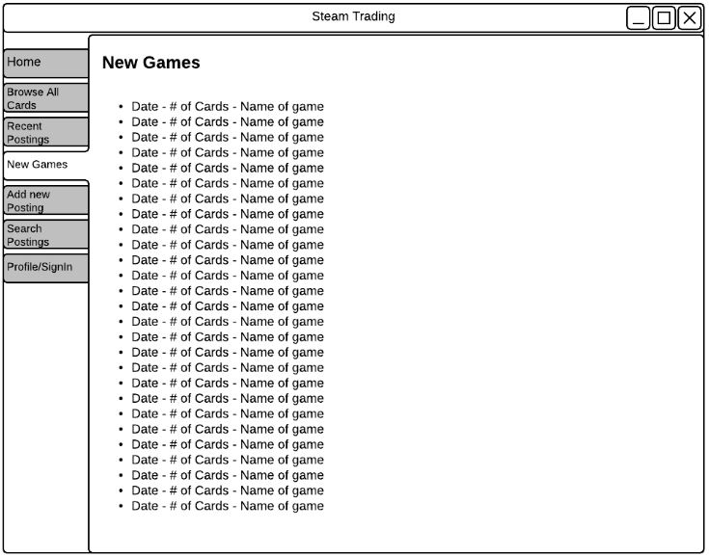
Mockup: Games

Slide 10
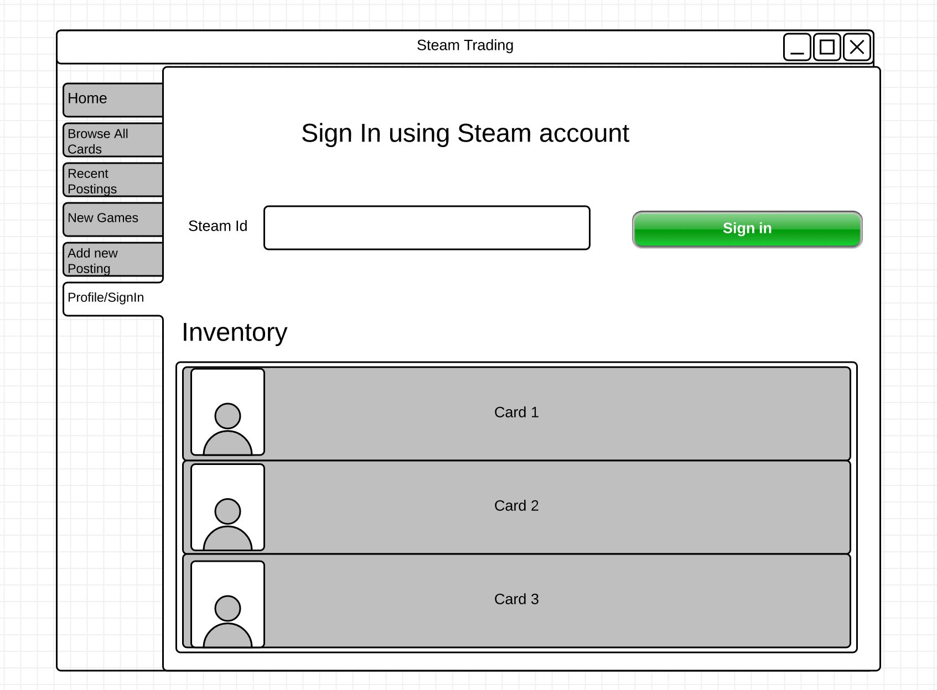
Mockup: Sign In

